Slide 1
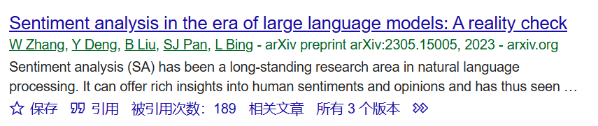
Sentiment analysis in the era of large language models: A reality check
Compare LLM with SLM in different sentiment analysis (SA) questions

Slide 2
Candidate LLMs
Flan-T5
Flan-UL2
Text-003
ChatGPT(3.5turbo)
SLM:
T5 large

Slide 3
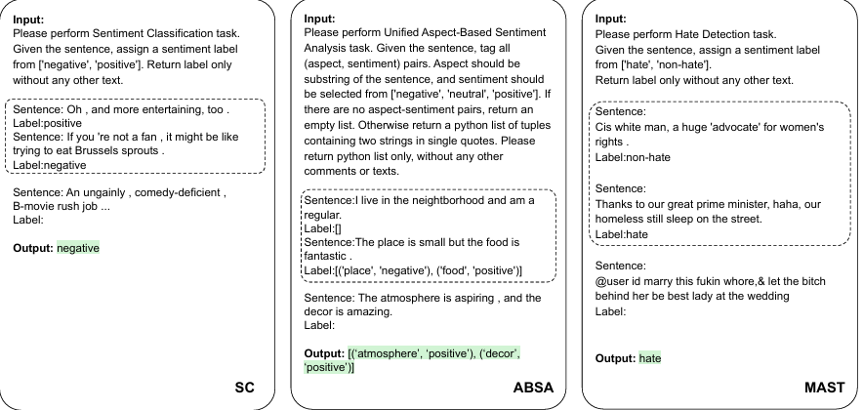
Task datasets
Sentiment Classification(SC)
Aspect-based Sentiment Analysis(ABSA)
Multifaceted Analysis of Subjective Text(MAST)

Slide 4
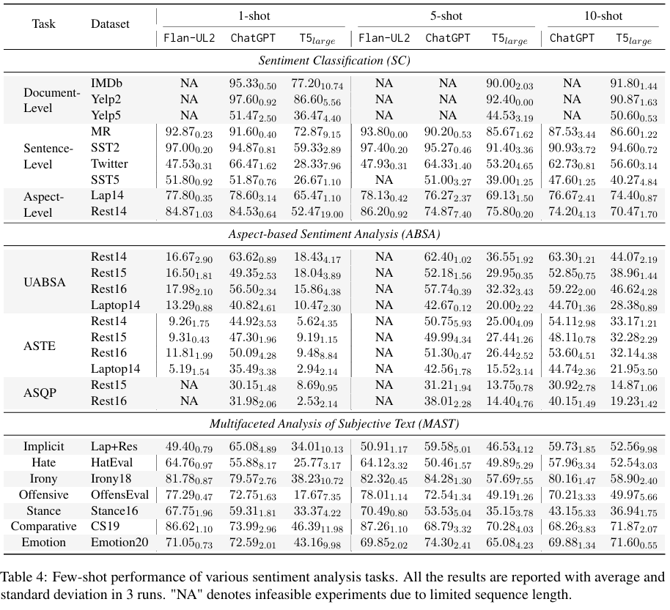
Outcome

Slide 5
Candidate LLMs
Flan-T5
Flan-UL2
Text-003
ChatGPT(3.5turbo)
SLM:
T5 large

